Slide 1

Department of Computer Science
University Institute of Engineering
DEPARTMENT OF COMPUTER SCIENCE & ENGINEERING
Bachelor of Engineering
Subject Name: System Programming
Subject Code: CST-315
Compilers
DISCOVER . LEARN . EMPOWER

Slide 2
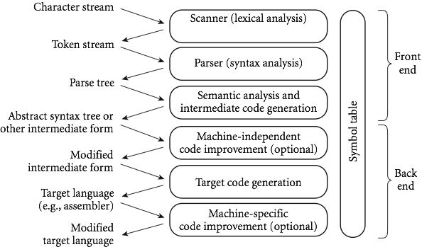

An Overview of Compilation
Phases of Compilation

Slide 3
Phase 1. Lexical Analysis

Slide 4
Phase 1. Lexical Analysis
Lexical Analysis is the first phase when compiler scans the source code.
This process can be left to right, character by character, and group these characters into tokens.
A token is a sequence of Characters having a collective meaning.
Here, the character stream from the source program is grouped in meaningful sequences by identifying the tokens.
It makes the entry of the corresponding tokens into the symbol table and passes that token to next phase.

Slide 5
Phase 1. Lexical Analysis
The primary functions of this phase are:
Identify the lexical units in a source code
Classify lexical units into classes like constants, reserved words, and enter them in different tables.
It will Ignore comments in the source program
Identify token which is not a part of the language

Slide 6
An Overview of Compilation
x = y + 10
Tokens
X identifier
= Assignment operator
Y identifier
+ Addition operator
10 Number

Slide 7
Phase 2: Syntax Analysis

Slide 8
Phase 2: Syntax Analysis
Syntax analysis is all about discovering structure in code.
It determines whether or not a text follows the expected format.
The main aim of this phase is to make sure that the source code was written by the programmer is correct or not.
Syntax analysis is based on the rules based on the specific programming language by constructing the parse tree with the help of tokens.
It also determines the structure of source language and grammar or syntax of the language.

Slide 9
Phase 2: Syntax Analysis
Here, is a list of tasks performed in this phase:
Obtain tokens from the lexical analyzer
Checks if the expression is syntactically correct or not
Report all syntax errors
Construct a hierarchical structure which is known as a parse tree

Slide 10
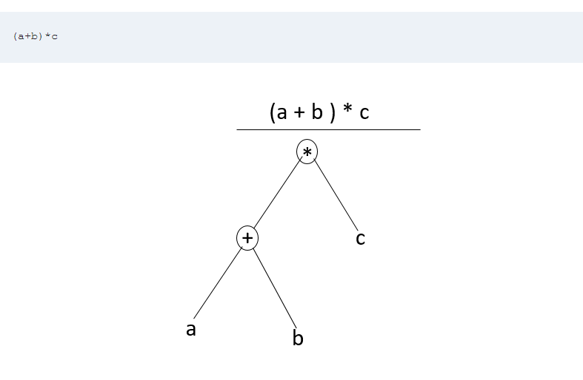
An Overview of Compilation

Slide 11
Phase 3: Semantic Analysis

Slide 12
Phase 3: Semantic Analysis
Semantic analysis checks the semantic consistency of the code.
It uses the syntax tree of the previous phase along with the symbol table to verify that the given source code is semantically consistent.
It also checks whether the code is conveying an appropriate meaning.
Semantic Analyzer will check for Type mismatches, incompatible operands, a function called with improper arguments, an undeclared variable, etc.

Slide 13
Phase 3: Semantic Analysis
Functions of Semantic analyses phase are:
Helps you to store type information gathered and save it in symbol table or syntax tree
Allows you to perform type checking
In the case of type mismatch, where there are no exact type correction rules which satisfy the desired operation a semantic error is shown
Collects type information and checks for type compatibility
Checks if the source language permits the operands or not

Slide 14
Phase 3: Semantic Analysis
Example
float x = 20.2;
float y = x*30;
In the above code, the semantic analyzer will typecast the integer 30 to float 30.0 before multiplication

Slide 15
Phase 4: Intermediate Code Generation
Once the semantic analysis phase is over the compiler, generates intermediate code for the target machine.
It represents a program for some abstract machine.
Intermediate code is between the high-level and machine level language.
This intermediate code needs to be generated in such a manner that makes it easy to translate it into the target machine code.

Slide 16
Phase 4: Intermediate Code Generation
Functions on Intermediate Code generation:
It should be generated from the semantic representation of the source program
Holds the values computed during the process of translation
Helps you to translate the intermediate code into target language

Slide 17
Phase 4: Intermediate Code Generation
Example
total = count + rate * 5
Intermediate code with the help of address code method is:
t1 := int_to_float(5)
t2 := rate * t1
t3 := count + t2
total := t3

Slide 18
Phase 5: Code Optimization
This phase removes unnecessary code line and arranges the sequence of statements to speed up the execution of the program without wasting resources.
The main goal of this phase is to improve on the intermediate code to generate a code that runs faster and occupies less space.

Slide 19
Phase 5: Code Optimization
The primary functions of this phase are:
Improves the running time of the target program
Generates streamlined code still in intermediate representation
Removing unreachable code and getting rid of unused variables

Slide 20
Phase 5: Code Optimization
Example: Consider the following code
a = intofloat(10)
b = c * a
d = e + b
f = d
Can become
b =c * 10.0
f = e+b

Slide 21
Phase 6: Code Generation
Code generation is the last and final phase of a compiler.
It gets inputs from code optimization phases and produces the page code or object code as a result.
The objective of this phase is to allocate storage and generate reloadable machine code.
It also allocates memory locations for the variable.

Slide 22
Phase 6: Code Generation
The instructions in the intermediate code are converted into machine instructions.
This phase coverts the optimize or intermediate code into the target language.
The target language is the machine code.
Therefore, all the memory locations and registers are also selected and allotted during this phase.
The code generated by this phase is executed to take inputs and generate expected outputs.

Slide 23
Phase 6: Code Generation
Example:
a = b + 60.0 Would be possibly translated to registers.
MOVF b, R1
MULF #60.0, R2
ADDF R1, R2

Slide 24
Phase 6: Code Generation
Symbol Table Management
A symbol table contains a record for each identifier with fields for the attributes of the identifier.
This component makes it easier for the compiler to search the identifier record and retrieve it quickly.
The symbol table also helps you for the scope management.
The symbol table and error handler interact with all the phases and symbol table update correspondingly.

Slide 25
Phase 6: Code Generation
Error Handling Routine:
In the compiler design process error may occur in all the below-given phases:
Lexical analyzer: Wrongly spelled tokens
Syntax analyzer: Missing parenthesis
Semantic Analysis Intermediate code generator: Mismatched operands for an operator
Code Optimizer: When the statement is not reachable
Code Generator: When the memory is full or proper registers are not allocated
Symbol tables: Error of multiple declared identifiers

Slide 26
The Phases of a Compiler
Phase | Output | Sample
Programmer (source code producer) | Source string | A=B+C;
Scanner (performs lexical analysis) | Token string | ‘A’, ‘=’, ‘B’, ‘+’, ‘C’, ‘;’ And symbol table with names
Parser (performs syntax analysis based on the grammar of the programming language) | Parse tree or abstract syntax tree | ; | = / \ A + / \ B C
Semantic analyzer (type checking, etc) | Annotated parse tree or abstract syntax tree
Intermediate code generator | Three-address code, quads, or RTL | int2fp B t1 + t1 C t2 := t2 A
Optimizer | Three-address code, quads, or RTL | int2fp B t1 + t1 #2.3 A
Code generator | Assembly code | MOVF #2.3,r1 ADDF2 r1,r2 MOVF r2,A
Peephole optimizer | Assembly code | ADDF2 #2.3,r2 MOVF r2,A

Slide 27
An Overview of Compilation
The languages accepted by some regular expression are referred to as Regular languages.
A regular expression can also be described as a sequence of pattern that defines a string.
Regular expressions are used to match character combinations in strings.
For instance:
In a regular expression, x* means zero or more occurrence of x. It can generate {empty, x, xx, xxx, xxxx, .....}
In a regular expression, x⁺ means one or more occurrence of x. It can generate {x, xx, xxx, xxxx, .....}

Slide 28
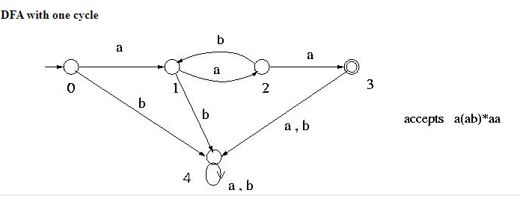
An Overview of Compilation

Slide 29
References
Department of computer Science
[PDF] Systems Programming and Operating Systems by Dhamdhere - Free Download PDF (dlscrib.com)
[PDF] Principles of Compiler Design By Alfred V. Aho & J.D.Ullman Free Download – Learnengineering.in

Slide 30
THANK YOU

